Slide 1
K-NEAREST NEIGHBOR CLASSIFICATION
1

Slide 2
WHY NEAREST NEIGHBOR?
Used to classify objects based on closest training examples in the feature space
  Feature space: raw data transformed into sample vectors of fixed length using feature extraction (Training Data)
Among the simplest of all Data Mining Algorithms
  Classification Method
Implementation of lazy learner
  All computation deferred until classification
?
4

Slide 3
k NEAREST NEIGHBOR
Requires 3 things:
  Feature Space(Training Data)
  Distance metric
    to compute distance between records
  The value of k
    the number of nearest neighbors to retrieve from which to get majority class
To classify an unknown record:
  Compute distance to other training records
  Identify k nearest neighbors
  Use class labels of nearest neighbors to determine the class label of unknown record
?
6
ICDM: Top Ten Data Mining Algorithms k nearest neighbor classification December 2006

Slide 4
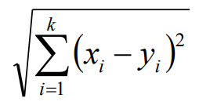
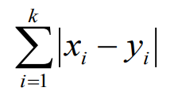
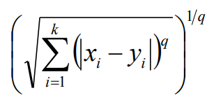
k NEAREST NEIGHBOR
Common Distance Metrics:
  Euclidean distance
  Manhatten distance
  Minkowski distance
7
ICDM: Top Ten Data Mining Algorithms k nearest neighbor classification December 2006

Slide 5
k NEAREST NEIGHBOR
k = 1:
Belongs to square class
k = 3:
Belongs to triangle class
?
k = 7:
Belongs to square class
Choosing the value of k:
  If k is too small, sensitive to noise points
  If k is too large, neighborhood may include points from other classes
  Choose an odd value for k, to eliminate ties
8
ICDM: Top Ten Data Mining Algorithms k nearest neighbor classification December 2006

Slide 6
k NEAREST NEIGHBOR
Accuracy of all NN based classification, prediction, or recommendations depends solely on a data model, no matter what specific NN algorithm is used.
Scaling issues
  Attributes may have to be scaled to prevent distance measures from being dominated by one of the attributes.
  Examples
    Height of a person may vary from 4’ to 6’
    Weight of a person may vary from 100lbs to 300lbs
    Income of a person may vary from $10k to $500k
Nearest Neighbor classifiers are lazy learners
  No pre-constructed models for classification
9
ICDM: Top Ten Data Mining Algorithms k nearest neighbor classification December 2006

Slide 7
k NEAREST NEIGHBOR ADVANTAGES
Simple technique that is easily implemented
Building model is inexpensive
Extremely flexible classification scheme
  does not involve preprocessing
Well suited for
  Multi-modal classes (classes of multiple forms)
  Records with multiple class labels
Asymptotic Error rate at most twice Bayes rate
  Cover & Hart paper (1967)
Can sometimes be the best method
  Michihiro Kuramochi and George Karypis, Gene Classification using Expression Profiles: A Feasibility Study, International Journal on Artificial Intelligence Tools. Vol. 14, No. 4, pp. 641-660, 2005
  K nearest neighbor outperformed SVM for protein function prediction using expression profiles
10
ICDM: Top Ten Data Mining Algorithms k nearest neighbor classification December 2006

Slide 8
k NEAREST NEIGHBOR DISADVANTAGES
Classifying unknown records are relatively expensive
  Requires distance computation of k-nearest neighbors
  Computationally intensive, especially when the size of the training set grows
Accuracy can be severely degraded by the presence of noisy or irrelevant features
NN classification expects class conditional probability to be locally constant
  bias of high dimensions
11
ICDM: Top Ten Data Mining Algorithms k nearest neighbor classification December 2006

